Slide 1
Introduction to Graphics

Slide 2
Course Plan
Intro to Geometric Transforms
Pipeline Module: Hierarchical Modeling and Viewing Transforms.
Perspective and Orthographic Projection
Rasterization, Clipping Points and Lines, Polygon Filling
Visibility, Illumination

Slide 3
Introduction to Geometric Transforms

Slide 4
What are geometric transforms in context of graphics?
Geometric transforms are basically a bijective mapping for every point in a set to a new position.
Eg :-
def move(x,y) :
return x+4,y+5
This is a geometric transform that moves every point +4 along the x-axis, and +5 along the y-axis.

Slide 5
Different kinds of geometric transforms
Scaling,Translation,Rotations,Reflections,Shearing etc.
We’ll be mainly looking at rotations, scaling, and translations here.

Slide 6
Representations of Points in 3D
Two common ways :-
Cartesian (x,y,z)
Polar (ρ,θ,φ)
Very straightforward, and easy conversion between the two. Equivalent in terms of representational power.
For simplicity, lets just work with (x,y,z) in this class, but be aware that we can shift between them if needed in the future.

Slide 7
Translation
V and t are a vector element of say R^{d}.
Say V is a vector that represents some point in d dimensional space, upon element wise addition of t to V, we are representing a new point V’, i.e. the point being represented by V’ is the position of the original point after translation.
V’ = V + t
Eg:- In 3D : V’([6,3,1]) = V([9,5,-2]) + t([-3,-2,3])
Distances, angles, parallelism are all maintained.

Slide 8
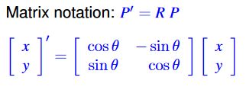
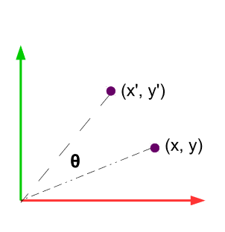
Rotation in 2D
Explanation as to how this is derived :-
https://www.youtube.com/watch?v=8XRvpDhTJpw
It is important to note, and understand that rotation of a point by theta degrees can also be seen as rotation of the x and y axis by -ve theta degrees. This is how the explanation in the link above inverts the signs of the two sin terms. cos terms aren’t affected by this as it’s an even function.

Slide 9
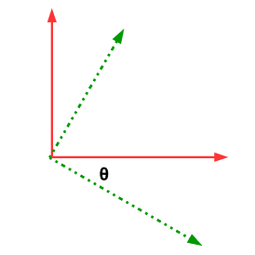
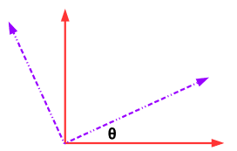
In the rotation matrix, rows and cols represent the following.
Rows : Vectors that rotate to the coordinate axis.
Columns : Vectors that the coordinate axis rotate to.
Also, note that rotation matrices are orthogonal, i.e. lengths and angles preserving, and have det = 1. In 3D, they form SO(3) group,i.e. special orthogonal matrix group with det = 1 in 3 dimensions. R^{T} = R⁻¹

Slide 10

Rotations in 3D
Can happen along any of the three axis, or an arbitrary axis (this however can be broken down into rotations along the three coordinate axis).
Rotation in 2D is basically rotation in 3D along z-axis. Along other axis the following rotation matrices are used.

Slide 11
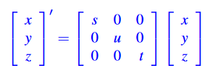
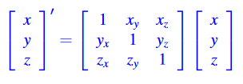
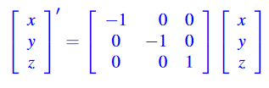
Scaling, Shearing, and Reflection
Matrix equation corresponds to non-uniform scaling. For uniform scaling, can replace with a single scalar instead of a matrix.
Shearing : Add a little bit of x to y or other combinations. Ratio of lengths in any particular direction, and parallelism preserved.
Reflection : Equation corresponds to about z-axis. Similarly done for reflection about other axis.

Slide 12
General Transformations, and Homogeneous Coordinates
All transformations shown previously can be done as matrix products, except translations, which is a vector addition.
P’ = R2[SR1(P+t1) +t2]
Sequence = ?
If we can keep translation also as matrix product,
P’ = ? (Fill as per sequence obtained above)
R2*T2*S*R1*T1*P
Solution? Homogeneous coordinates!

Slide 13
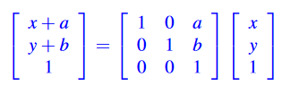
Homogeneous Coordinates
We represent a 3-D point using a 4-D vector wherein the final value gives us a scaling value.
[x y z w] represents [x/w y/w z/w] in 3D.
Now, a translation in 2D can be represented as :-
This similarly extends to rotation matrices as well(since dimensions of rotation and translation matrix must be the same), in which the last row and column becomes [0,0,1]. Idea is to have the last row not affect the values. This concept similarly extends into 3D.

Slide 14
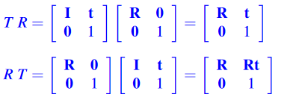
Points to note
Matrix multiplication isn’t commutative..
Meaning R*T != T*R unless in some specific cases.
Therefore order of transformations is paramount.
Scaling, and translations are commutative owing to the way they are constructed, but not rotations. Note that 4*4 matrix can account for both rotation and translation.

Slide 15
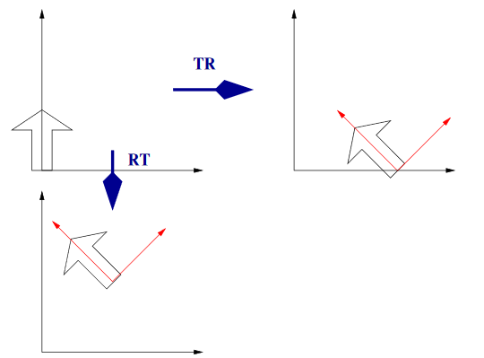
Therefore, to rotate or scale in place, do it first before translation, as all rotations/scale changes happen about origin.

Slide 16
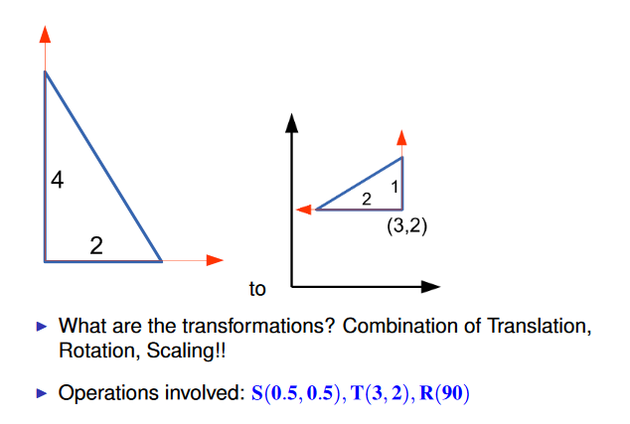
Exercise on the order of transformations

Slide 17
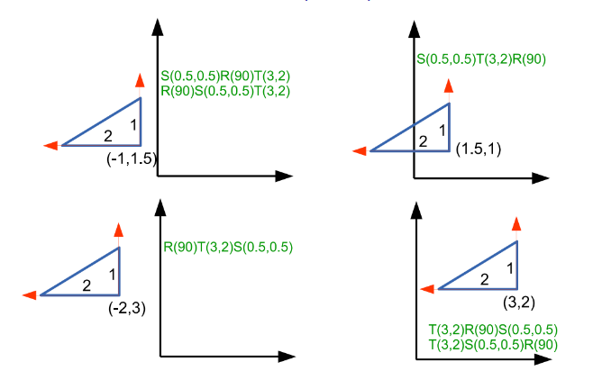

Slide 18
Rotation about an arbitrary axis
Any two coordinate frames (with a common origin) can also be related by a sequence of not more than three rotations about coordinate axes, where no two successive rotations are about the same axis. Originally shown by Euler.
Broad idea : Transform back to one of the coordinate axis, do required rotation about coordinate axis, then undo the first transformation we did thus bringing it to its new position.
Example, say we are rotating about an axis parallel to the x-axis by theta. P=[x,y,z] be the point the axis is passing through. Therefore, required transformation
M = T(0,y,z)*R(theta)_{z}*T(0,-y,-z)

Slide 19
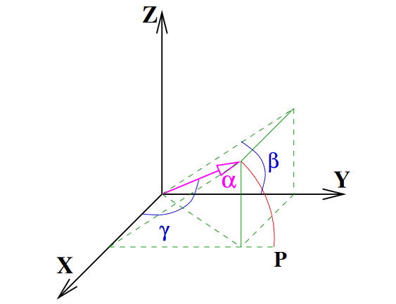
Rotation about a 3D axis
R_{α}(θ) =R⁻¹_{αx} * R_{x}(θ) * R_{αx}
If origin not aligned, translate until so as previously explained.
How do we find R_{αx} ?
We can do it by bringing it into either XZ or XY plane with a rotation about the x-axis, then bring it to the x-axis by rotating along the y or z axis respectively.
We can make use of the idea that rows of rotation matrices indicate the vectors that rotate to the coordinate axis.

Slide 20
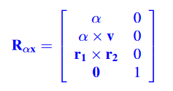
Second Method explanation
First row brings alpha to the x-axis.
V is any vector non-parallel to alpha. cross(alpha,v) gives a vector perpendicular to both.
Third row we just need an axis perpendicular to both our previously selected axis, which is cross(alpha,cross(alpha,v)).

Slide 21
Rotations about Fixed axis vs Moving axis(Euler angles)
Question ) Express rotation about x-axis first, then y-axis, then z-axis in terms of fixed and moving axis.
Fixed axis : All transforms happen about original coordinate axis.
Multiplications happening from right to left- Pre-multiplication
P’ = R_{z}*R_{y}*R_{x}*P
Moving axis : All transforms happen about current coordinate axis.
Multiplications happening from left to right - Post-multiplication
P’ = R_{x}*R_{y}*R_{z}*P
For proof and further explanation : Link

